Slide 1
The AUC International Conference for Research on African Challenges (ICRAC), No Poverty,
Governance and economic growth, empirical verification in the oil-producing countries of the CEMAC zone
TELIMSEIN ERICK

Slide 2
Presentation outline
Introduction problematic Some stylized facts Literature review Methodological approach Results recommendations

Slide 3
INTRODUCTION
. This article deals with governance and its effect on the economic growth of the countries of the CEMAC zone. on the one hand, that "good governance" positively influences growth in the CEMAC zone and, on the other hand, that these countries have every interest in initiating governance reforms to improve their economic growth and develop their economies. in view of the high volatility of oil prices, on which they depend, and the trend towards global energy transition

Slide 4
Research problem (1/3)
Research Question: What is the relationship between governance indicators and the economic performance of resource exporting countries in the CEMAC zone?

Slide 5
Research problem (2/3)
. Research objective: to assess respectively the impact that the six Kaufman indicators can have (the effectiveness of the government, the quality of the regulation, the rules of law, the political stability and the violence, the capacities demands and expression and the control of corruption) on the economic growth of these countries

Slide 6
Research problem (3/3)
. Interest and justification: bring together in the same field of economic analysis the six indicators of governance and see their effect. The case of the countries of the CEMAC zone is interesting for more than one reason. Indeed, despite the abundant natural resources that these countries have, they continue to suffer from underdevelopment problems.

Slide 7
Some stylized facts (1/7)
COUNTRY | proven reserves (in barrels)
Gabon | 2, 000, 000,000
Congo | 1, 600, 000,000
Tchad | 1, 500, 000,000
Guinée équatoriale | 1, 100, 000,000
Cameroun | 200, 000,000
République centrafricaine | 0
TOTAL | 6, 400, 000,000
Source : CIA World Factbook

Slide 8
Some stylized facts (2/7)

Slide 9
Some stylized facts (3/7)

Slide 10
Some stylized facts (4/7)

Slide 11
Some stylized facts (5/7) INFANT MORTALITY

Slide 12
Some stylized facts (6/7)
Taking the world average which is a score of 60 we note that sub-Saharan Africa is lagging behind with an average score of 53 points out of 100. But in the CEMAC zone the observation is that Gabon is the best ranked the quality of economic freedom with an average score of 57 points, which is above the average for sub-Saharan Africa. Cameroon follows with 53 points; Chad and Congo follow with respectively 45 and 43 points. Equatorial Guinea and RCA finished the podium with a respective average score of 39 and 36 points over the same period.

Slide 13
Some stylized facts (7/7)
Ranking and scores of countries in the CEMAC zone according to Corruption Perceptions Index 2017

Slide 14
LITERATURE REVIEW (1/2)
North (1990), the importance of institutional efficiency in explaining growth over the long term Knack and Keefer (1995) positive relationship between bureaucracy, property rights, political stability) and economic performance.
Mauro (1995), Gyimah-Brempong (2002), Mo (2001) that corruption reduces the economic growth of these countries.
Rodrik et al. (2004) have shown that when it comes to explaining income disparities between poor and rich countries, institutional quality takes precedence over geography and international trade.

Slide 15
LITERATURE REVIEW (2/2)
Kaufmann and Kraay (2002, 2003) argue that levels of governance and per capita income are strongly correlated. Good governance leads to higher per capita income levels
Subramanian and Sala-I-Martin (2003), the '' curse of natural resources '' is a purely institutional phenomenon.
Ross (2001), Wantchekon (2002) and Collier (2005) show that the worst scores for democracy are those of the oil-exporting countries

Slide 16
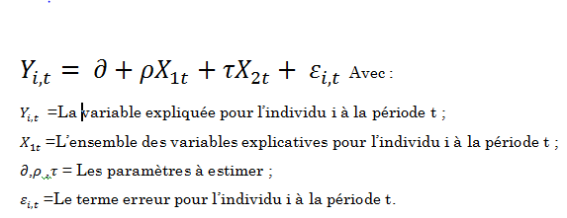
METHODOLOGY (1/3)
Avec :

Slide 17
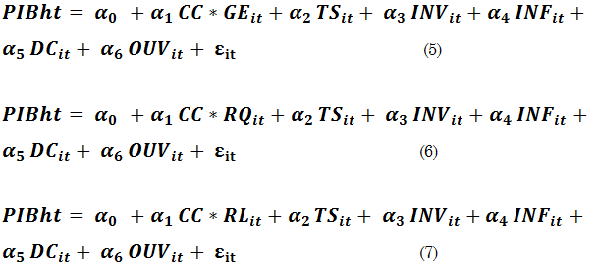
METHODOLOGY (2/3)

Slide 18
METHODOLOGY (3/3)
As for the estimations, they were made with the PANEL LEAST SUQARES estimator using the EVIEWS 10 software. The choice of this method was motivated by the fact that it allows to have robustness in our results while responding to problems of simultaneity bias, reverse causality, and omitted variables (Blundell and Bond, 1998).

Slide 19
RESULTS (1/4)
Variables | Modèle 1 | Modele2 | Modèle 3 | Modèle 4 | Modèle 5 | Modèle 6
DOUVERT | 0.068057 (0.0915)* | 0.108435 (0.0179)*** | 0.063804 (0.1545) | 0.078187 (0.0589)** | 0.070259 (0.0817)* | 0.066567 (0.0870)*
INVPIB | 0.282585 (0.0058) *** | 0.373820 (0.0014)*** | 0.331916 (0.0022)*** | 0.284791 (0.0075)*** | 0.304022 (0.0029)*** | 0.268869 (0.0069)***
DS | 0.665774 (0.0160)*** | -0.675935 (0.0636)* | -0.686226 (0.0228)** | -0.697443 (0.0163)** | -0.816831 (0.0055)*** | -0.741675 (0.0069)***
INF | -0.342859 (0.0727) | -0.174779 (0.4079) | -0.286179 (0.1552) | -0.405701 (0.0503) | -0.342402 (0.0742) | -0.350192 (0.0582)*
TS | 0.081180 (0.3229) | 0.143403 (0.1541) | 0.129460 (0.1474) | 0.099054 (0.2455) | 0.122637 (0.1418) | 0.071438 (0.3703)
VA | -6.902654 (0.0002)***
PS |  | -2.198916 (0.1044)
GE |  |  | -5.565760 (0.0034)***
RQ |  |  |  | -7.249897 (0.0009)***
RL |  |  |  |  | -6.352079 (0.0003)***
CC |  |  |  |  |  | -7.505610 (0.0001)***

Slide 20
RESULTS 2/4
Government Effectiveness has a negative and significant effect on economic growth because of the quality of public services, the quality of government service and the degree of their independence from political pressures, policies to improve the efficiency of the public sector including budget management, government capacity to solve development problems
The quality of regulation (Regulatory Quality) also has a negative impact on growth because the government's capacity to formulate and put in place strong policies and regulations that promote the private sector are non-existent in these countries.

Slide 21
RESULTS (3/4)
Rule of Law is another governance problem for these countries as their people have lost confidence in the state because of abuses and authoritarian management, particularly with regard to the implementation of the rule of law. implementation of contracts, property rights, police, and justice, as well as the likelihood of crime and violence.
Corruption (Control of Corruption) has a negative effect on growth because this part of Africa the big corruption is very present because of the oil exploitation and the fact that the circle of the governors only diverted the resources and the Capital leaks are regular which has a very negative influence on growth in these countries.

Slide 22
RESULT 4/4
IN CONCLUSION The ineffectiveness of the government, the poor quality of the regulation within its countries, the rules of the law are not applied, the corruption very present especially the big corruption with consequences of the exits of currencies of the zone, finally this leads to an increase in claims and expression capacities These results confirm the conclusions of Kaufman et al. (2003), Barro and Sala-i-Martin (1995) and Mankiw, Romer and Weil (1992).

Slide 23
Recommendations
The fight against corruption as it undermines the smooth functioning of markets and the efficiency of administration and justice. It degrades the image of the area to investors and hinders investment initiatives
The establishment of strong and sustainable institutions to promote good governance, democratic alternation, efficient social justice and restore confidence between the people and their leaders;
Put in place policies to improve the efficiency of the public sector including budget management, increase the capacity of the government to solve development problems, improve the quality of infrastructure necessary for business development;

Slide 24
promote the private sector including consistency and predictability in the interpretation of laws and regulations, distortions and complexity of the tax system, unfair competitive practices, heaviness administrative regulations, the ease of doing business and the rigidity of labor legislation;

Slide 25
THANK YOU FOR YOUR KIND ATTENTION

